Slide 1

Microsoft Build

Slide 2

Vector search and state-of-the-art retrieval for generative AI apps​
Alvaro Videla
Principal Cloud Advocate (Data)​

Slide 3
Vector search and state-of-the-art retrieval for generative AI apps​

Slide 4
Agenda
Retrieval-augmented generation (RAG)​
Vectors and vector databases​
State of the art retrieval with Azure AI Search​
Data and platform integrations​
Use cases

Slide 5
Retrieval-augmented generation (RAG)​
Notes:
Generación de Recuperación Aumentada (GRA)

Slide 6
Generación de Recuperación aumentada (GRA)
Notes:
Generación de Recuperación Aumentada (GRA)

Slide 7
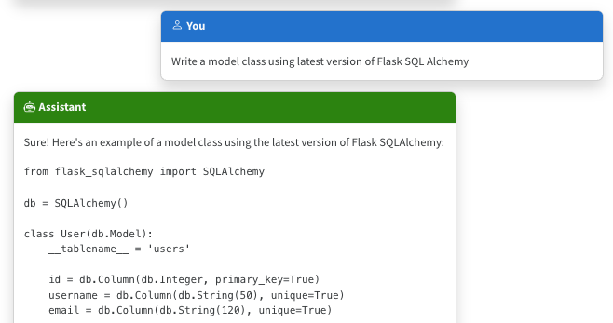
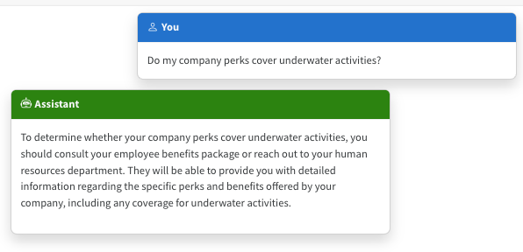
The limitations of LLMS
Outdated public knowledge
No internal knowledge
Notes:
Now, let's talk about building our own Copilots. In that case, you'll build your own Copilot code with orchestration either built on your own code or maybe one of the popular open-source frameworks.
Then you'll need a retrieval system that can capture data from whatever it is that you store it. Maybe in some database systems, maybe these are PDFs and Office documents in Blob Storage, or who knows?
This retrieval system is then what would allow you to retrieve the bits and pieces required to answer any particular question or interaction.
Then you'll use a language model like the Azure OpenAI GPT models to actually apply reasoning to that content and produce a response.

Slide 8
Incorporating domain knowledge
Prompt engineering
Fine tuning
Retrieval augmentation
In-context learning
Learn new skills
(permanently)
Learn new facts
(temporarily)

Slide 9
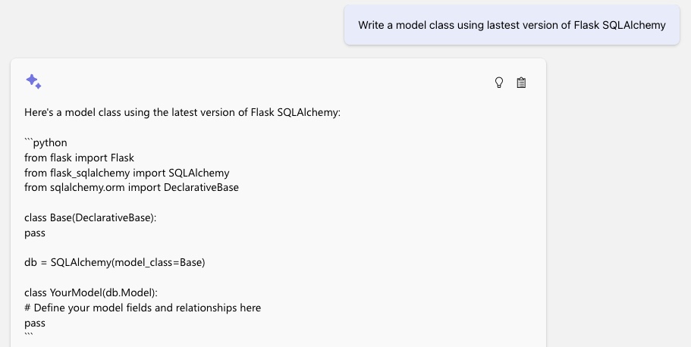
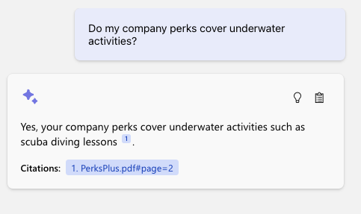
The benefit of RAG
Up-to-date public knowledge
Access to internal knowledge
Notes:
Now, let's talk about building our own Copilots. In that case, you'll build your own Copilot code with orchestration either built on your own code or maybe one of the popular open-source frameworks.
Then you'll need a retrieval system that can capture data from whatever it is that you store it. Maybe in some database systems, maybe these are PDFs and Office documents in Blob Storage, or who knows?
This retrieval system is then what would allow you to retrieve the bits and pieces required to answer any particular question or interaction.
Then you'll use a language model like the Azure OpenAI GPT models to actually apply reasoning to that content and produce a response.
Demo note: Bring up the repo, show thought process or supporting content

Slide 10




RAG – Retrieval Augmented Generation
Yes, your company perks cover underwater activities such as scuba diving lessons ¹
Do my company perks cover underwater activities?
PerksPlus.pdf#page=2: Some of the lessons covered under PerksPlus include: · Skiing and snowboarding lessons · Scuba diving lessons · Surfing lessons · Horseback riding lessons These lessons provide employees with the opportunity to try new things, challenge themselves, and improve their physical skills.….
User
Question
Document Search
Large Language Model
💻 Demo: RAG app thought process (aka.ms/azai/python)
Notes:
Now, let's talk about building our own Copilots. In that case, you'll build your own Copilot code with orchestration either built on your own code or maybe one of the popular open-source frameworks.
Then you'll need a retrieval system that can capture data from whatever it is that you store it. Maybe in some database systems, maybe these are PDFs and Office documents in Blob Storage, or who knows?
This retrieval system is then what would allow you to retrieve the bits and pieces required to answer any particular question or interaction.
Then you'll use a language model like the Azure OpenAI GPT models to actually apply reasoning to that content and produce a response.

Slide 11
Robust retrieval for RAG apps
Responses only as good as retrieved data
Keyword search recall challenges
“vocabulary gap”
Gets worse with natural language questions
Vector-based retrieval finds documents by semantic similarity
Robust to variation in how concepts are articulated (word choices, morphology, specificity, etc.)
Example
Question:
“Looking for lessons on underwater activities”
Won’t match:
“Scuba classes”
“Snorkeling group sessions”

Slide 12
Vectors and vector databases​

Slide 13
Vector embeddings
An embedding encodes an input as a list of floating-point numbers.
”dog” → [0.017198, -0.007493, -0.057982, 0.054051, -0.028336, 0.019245,…]
Different models output different embeddings, with varying lengths.
Model | Encodes | Vector length
word2vec | words | 300
Sbert (Sentence-Transformers) | text (up to ~400 words) | 768
OpenAI ada-002 | text (up to 8191 tokens) | 1536
Azure Computer Vision | image or text | 1024
….and many more models!
💻 Demo: Compute a vector with ada-002 (aka.ms/aitour/vectors)
Notes:
https://platform.openai.com/docs/guides/embeddings/use-cases
https://www.reddit.com/r/MachineLearning/comments/13aaj2w/d_is_openai_textembeddingada002_the_best/
https://vickiboykis.com/what_are_embeddings/next.html

Slide 14
General Setup
import json
import os
import azure.identity
import dotenv
import numpy as np
import openai
import pandas as pd

Slide 15
General Setup
# Set up OpenAI client based on environment variables
dotenv.load_dotenv()
AZURE_OPENAI_SERVICE = os.getenv("AZURE_OPENAI_SERVICE")
AZURE_OPENAI_ADA_DEPLOYMENT = os.getenv("AZURE_OPENAI_ADA_DEPLOYMENT")

Slide 16
General Setup
azure_credential = azure.identity.DefaultAzureCredential()
token_provider = azure.identity.get_bearer_token_provider(azure_credential,
"https://cognitiveservices.azure.com/.default")
openai_client = openai.AzureOpenAI(
api_version="2023-07-01-preview",
azure_endpoint=f"https://{AZURE_OPENAI_SERVICE}.openai.azure.com",
azure_ad_token_provider=token_provider)

Slide 17
General Setup
azure_credential = azure.identity.DefaultAzureCredential()
token_provider = azure.identity.get_bearer_token_provider(azure_credential,
"https://cognitiveservices.azure.com/.default")
openai_client = openai.AzureOpenAI(
api_version="2023-07-01-preview",
azure_endpoint=f"https://{AZURE_OPENAI_SERVICE}.openai.azure.com",
azure_ad_token_provider=token_provider)

Slide 18
Embedding helpers
def get_embedding(text):
get_embeddings_response = openai_client.embeddings.create(
model=AZURE_OPENAI_ADA_DEPLOYMENT, input=text)
return get_embeddings_response.data[0].embedding
def get_embeddings(sentences):
embeddings_response = openai_client.embeddings.create(
model=AZURE_OPENAI_ADA_DEPLOYMENT, input=sentences)
return [embedding_object.embedding for embedding_object
in embeddings_response.data]

Slide 19
Embedding helpers
vector = get_embedding("im more of a cat person
than a dog person but
actually these days i just like humans")
[-0.022648831829428673, 0.006634126417338848,
-0.02030368708074093, -0.02884402684867382,
-0.009123491123318672, 0.010998353362083435,
0.009123491123318672, ...]
len(vector) => 1536

Slide 20
Document similarity modeled as cosine distance
def cosine_similarity(a, b):
return np.dot(a, b) / (np.linalg.norm(a)
* np.linalg.norm(b))
sentences1 = ['The new movie is awesome’,
'The new movie is awesome’,
'The new movie is awesome']
sentences2 = ['djkshsjdkhfsjdfkhsd’,
'This recent movie is so good’,
'The new movie is awesome']
embeddings1 = get_embeddings(sentences1)
embeddings2 = get_embeddings(sentences2)
for i in range(len(sentences1)):
print(f"{sentences1[i]} \t\t {sentences2[i]} \t\t Score:
{cosine_similarity(embeddings1[i], embeddings2[i]):.4f}")

Slide 21
Document similarity modeled as cosine distance
The new movie is awesome djkshsjdkhfsjdfkhsd Score: 0.7467
The new movie is awesome This recent movie is so good Score: 0.9191
The new movie is awesome The new movie is awesome Score: 1.0000

Slide 22
Vector similarity
We compute embeddings so that we can calculate similarity between inputs.
The most common distance measurement is cosine similarity.
def cosine_sim(a, b):
return dot(a, b) /
(mag(a) * mag(b))
Similar:
θ near 0
cos(θ) near 1
Orthogonal:
θ near 90
cos(θ) near 0
Opposite:
θ near 180
cos(θ) near -1
*For ada-002, cos(θ) values range from 0.7-1
💻 Demo: Compare vectors with cosine similarity (aka.ms/aitour/vectors)
🔗 Demo: Vector Embeddings Comparison (aka.ms/aitour/vector-similarity)
Notes:
https://platform.openai.com/docs/guides/embeddings/use-cases
https://www.reddit.com/r/MachineLearning/comments/13aaj2w/d_is_openai_textembeddingada002_the_best/
https://vaibhavgarg1982.medium.com/why-are-cosine-similarities-of-text-embeddings-almost-always-positive-6bd31eaee4d5

Slide 23
Vector search
Compute the embedding vector for the query
Find K closest vectors for the query vector
Search exhaustively or using approximations
Compute embedding vector
Search
existing vectors
K closest vectors
Query
Query vector
[[“snake”, [-0.122, ..],
[“frog”, [-0.045, ..]]]
OpenAI ada-002 create embedding
[-0.003335318, -0.0176891904,…]
Search
existing vectors
“tortoise”
💻 Demo: Search vectors with query vector (aka.ms/aitour/vectors)

Slide 24
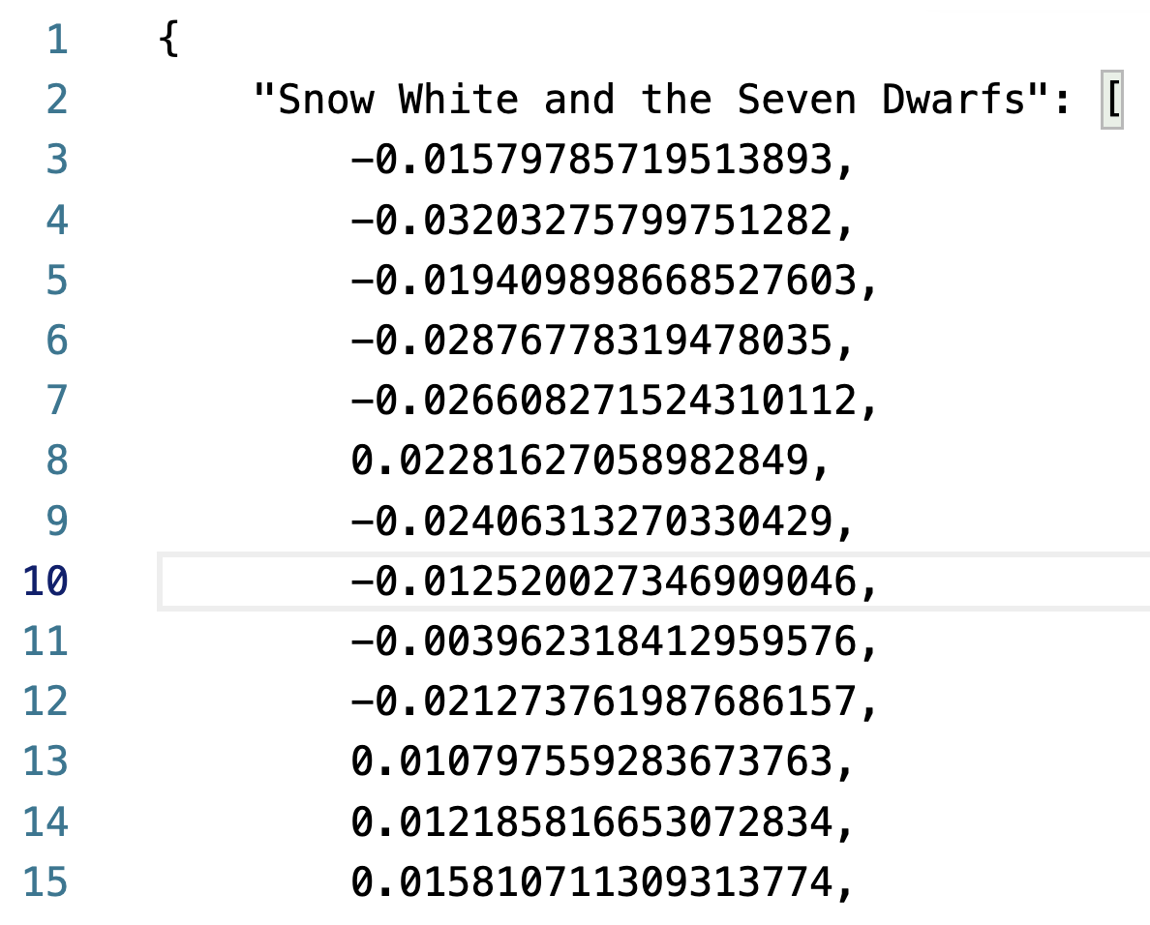
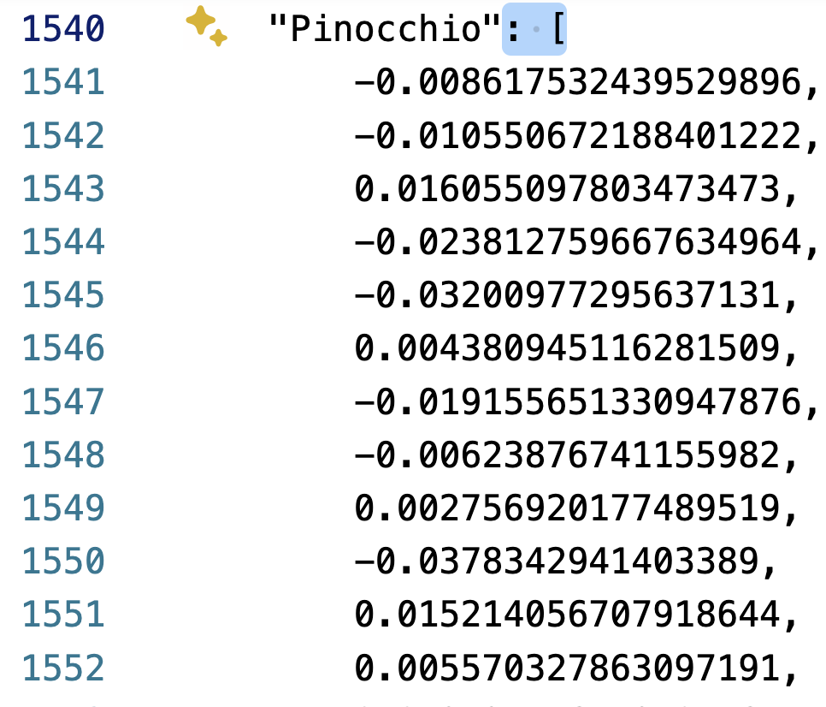
Vector Search Example
with open('openai_movies.json') as json_file:
movie_vectors = json.load(json_file)

Slide 25
Vector Search Example
# Compute vector for query
query = "My Neighbor Totoro"
embeddings_response =
openai_client.embeddings.create(
model=AZURE_OPENAI_ADA_DEPLOYMENT, input=[query])
vector = embeddings_response.data[0].embedding

Slide 26
Vector Search Example
# Compute cosine similarity between query and each movie title
scores = []
for movie in movie_vectors:
scores.append((movie, cosine_similarity(vector, movie_vectors[movie])))
# Display the top 10 results
df = pd.DataFrame(scores, columns=['Movie', 'Score'])
df = df.sort_values('Score', ascending=False)
df.head(10)

Slide 27
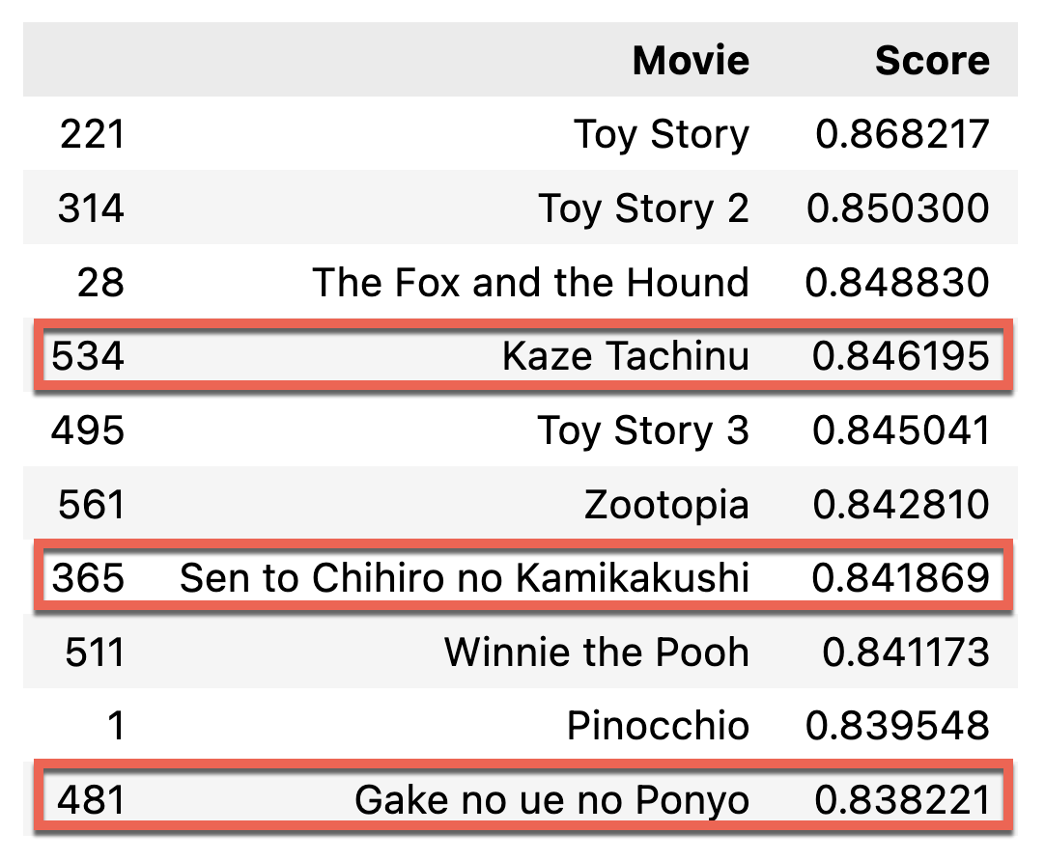
Vector Search Example
query = "My Neighbor Totoro"

Slide 28
Vector databases
PostgreSQL with pgvector example:
Durably store and index vectors and metadata at scale
Various indexing & retrieval strategies
Combine vector queries with metadata filters
Enable access control
CREATE EXTENSION vector;
CREATE TABLE items (id bigserial PRIMARY KEY,
embedding vector(1536));
INSERT INTO items (embedding) VALUES
('[0.0014701404143124819,
0.0034404152538627386,
-0.012805989943444729,...]');
SELECT * FROM items
ORDER BY
embedding <=> '[-0.01266181, -0.0279284,...]’
LIMIT 5;
CREATE INDEX ON items
USING hnsw (embedding vector_cosine_ops);

Slide 29



Vector databases in Azure
Vectors in Azure databases
Keep your data where it is: native vector search capabilities
Built into Azure Cosmos DB MongoDB vCore and Azure Cosmos DB for PostgreSQL services
Azure AI Search
Best relevance: highest quality of results out of the box
Automatically index data from Azure data sources: SQL DB, Cosmos DB, Blob Storage, ADLSv2, and more
Notes:
Vector Database => Retrieval Tool, como obtener resultados exactos y relevantes. Retrieval = extracción

Slide 30
Retrieval databases in Azure
Vectors in Azure databases
Keep your data where it is: native vector search capabilities
Built into Azure Cosmos DB MongoDB vCore and Azure Cosmos DB for PostgreSQL services
Azure AI Search
Best relevance: highest quality of results out of the box
Automatically index data from Azure data sources: SQL DB, Cosmos DB, Blob Storage, ADLSv2, and more
Notes:
Vector Database => Retrieval Tool, como obtener resultados exactos y relevantes.
Retrieval = extracción

Slide 31

Azure AI Search
Feature rich, enterprise-ready vector database
Data and platform integration
State-of-the-art retrieval system
*Previously known as Azure Cognitive Search
Notes:
secure information retrieval at scale for generative AI search applications
More than an index. Re-ranking.

Slide 32

Azure AI Search
Feature-rich vector database
Ingest any data type, from any source
Seamless data & platform integrations
State-of- the-art search ranking
Enterprise-ready foundation
Generally available
Generally available
Generally available
Vector search
Azure AI Search in Azure AI Studio
Semantic ranker
Integrated vectorization
Notes:
Azure AI Search offers leading technology that enable customers to build optimal RAG, which in turn results in a more accurate AI experience.
Hybrid search – AI has made vector search popular today. Keyword/text search is the capability most are familiar with, it's what powers our traditional search bar in our browser. While vector search allows you to search any time of data, images, audio, video, in addition to text, vector search is powered by different algorithms than keyword search is – by being able to use both capabilities, your responses will be quicker and more accurate.
Index data of any type: audio, video, images, and from sources including SQL DB, Cosmos, Blob storage ADLSv2

Slide 33
Vector search in Azure AI Search​
Feature rich, enterprise-ready​

Slide 34

Vector search in Azure AI Search
Generally available
Comprehensive vector search solution
Enterprise-ready
→ scalability, security and compliance
Integrated with Semantic Kernel, LangChain, LlamaIndex, Azure OpenAI Service, Azure AI Studio, and more
💻 Demo: Azure AI search with vectors
(aka.ms/aitour/azure-search)
Notes:
Now, let's start with the fundamentals, let's talk about core Vector search in Azure AI search. In Azure AI Search you will find all the core capabilities that you need in order to create a solution for vector-based retrieval. This includes all the core functionality in addition to enterprise readiness and integration with all the popular open source frameworks like Semantic Kernel, LangChain and more. I'm excited to share that.
As today, Vector search in Azure AI Search is generally available and ready for production applications. Let me show you this in action. What we'll do is you've seen a lot of complete applications and UIs today. I want to peel all these layers and show you exactly how you start from scratch and build one of these vector-retrieval systems.

Slide 35
Vector Search Example – Index Fields
AZURE_SEARCH_TINY_INDEX = "eentsyweentsy-index23"
fields = [
SimpleField(name="id", type=SearchFieldDataType.String, key=True),
SearchField(name="embedding",
type=SearchFieldDataType.Collection(SearchFieldDataType.Single),
searchable=True,
vector_search_dimensions=3,
vector_search_profile_name="embedding_profile")
]

Slide 36
Vector Search Example - Config
# Hierachical Navigable Small World, IVF
vector_search = VectorSearch(
algorithms=[HnswAlgorithmConfiguration(
name="hnsw_config",
kind=VectorSearchAlgorithmKind.HNSW,
parameters=HnswParameters(metric="cosine"),
)],
profiles=[VectorSearchProfile(name="embedding_profile",
algorithm_configuration_name="hnsw_config")]
)

Slide 37
Vector Search Example
index = SearchIndex(
name=AZURE_SEARCH_TINY_INDEX,
fields=fields,
vector_search=vector_search
)
index_client = SearchIndexClient(endpoint=AZURE_SEARCH_ENDPOINT, credential=azure_credential)
index_client.create_index(index)

Slide 38
Vector Search Example
search_client.upload_documents(documents=[
{"id": "1", "embedding": [1, 2, 3]},
{"id": "2", "embedding": [1, 1, 3]},
{"id": "3", "embedding": [4, 5, 6]}])

Slide 39
Vector Search Example
r = search_client.search(search_text=None,
vector_queries=[ VectorizedQuery(vector=[-2, -1, -1], k_nearest_neighbors=3, fields="embedding")])
for doc in r:
print(f"id: {doc['id']}, score: {doc['@search.score']}")
id: 2, score: 0.36515692
id: 1, score: 0.3480838
id: 3, score: 0.34124053

Slide 40
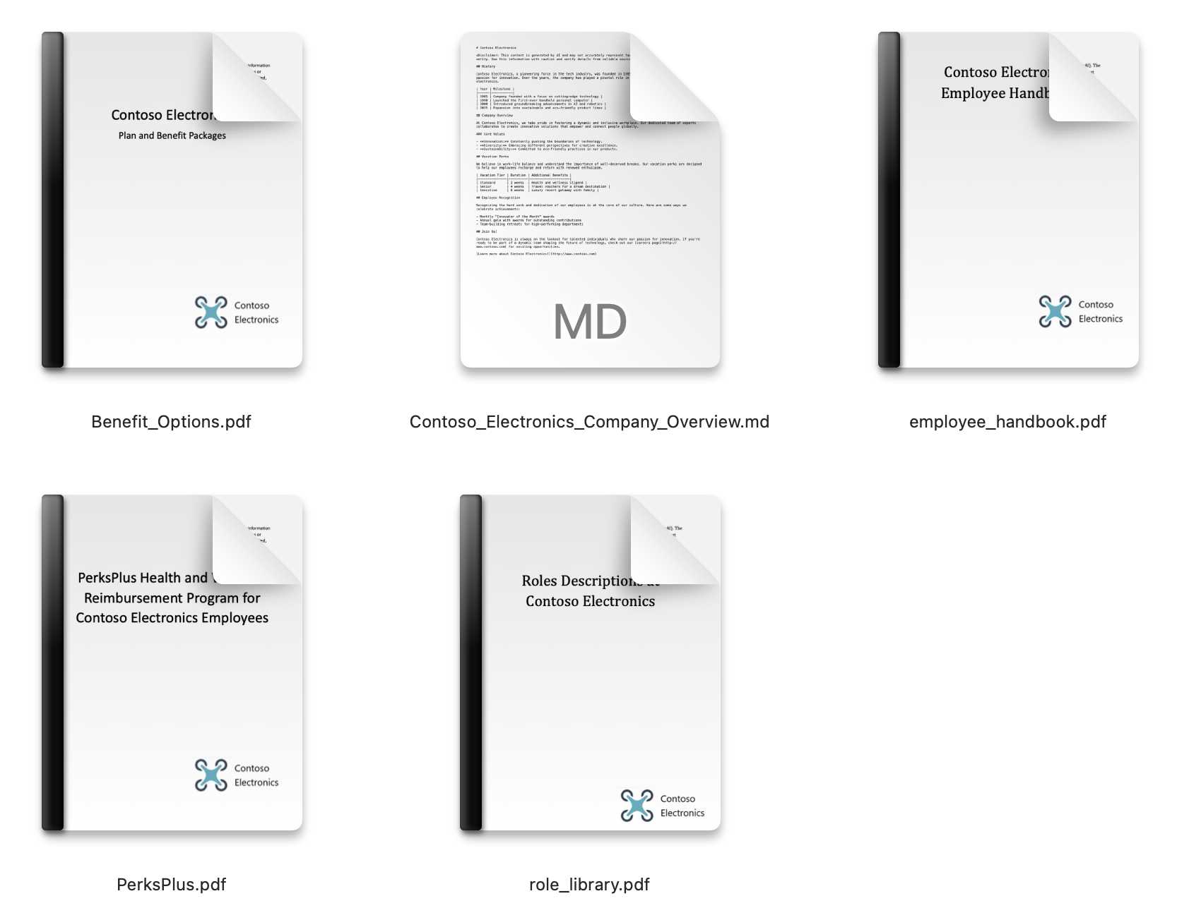
Vector Search Example: Company Perks PDFs

Slide 41
Vector Search Example: Company Perks PDFs
AZURE_SEARCH_FULL_INDEX = "gptkbindex"
search_client = SearchClient(AZURE_SEARCH_ENDPOINT, AZURE_SEARCH_FULL_INDEX, credential=azure_credential)
search_query = "learning about underwater activities"
search_vector = get_embedding(search_query)
r = search_client.search(search_text=None, top=5, vector_queries=[
VectorizedQuery(vector=search_vector, k_nearest_neighbors=5, fields="embedding")])
for doc in r:
content = doc["content"].replace("\n", " ")[:150]
print(f"Score: {doc['@search.score']:.5f}\tContent:{content}")

Slide 42
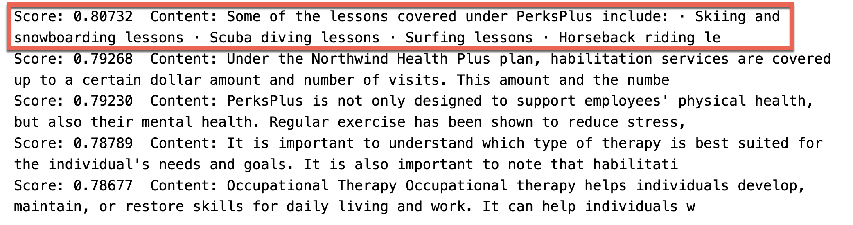
Vector Search Example: Company Perks PDFs

Slide 43
Vector search strategies
ANN search
Exhaustive KNN search
ANN = Approximate Nearest Neighbors
Fast vector search at scale
Uses HNSW, a graph method with excellent performance-recall profile
Fine control over index parameters
KNN = K Nearest Neighbors
Per-query or built into schema
Useful to create recall baselines
Scenarios with highly selective filters
e.g., dense multi-tenant apps
r = search_client.search(
None,
top=5,
vector_queries=[VectorizedQuery(
vector=search_vector,
k_nearest_neighbors=5,
fields="embedding")])
r = search_client.search(
None,
top=5,
vector_queries=[VectorizedQuery(
vector=search_vector,
k_nearest_neighbors=5,
fields="embedding",
exhaustive=True)])
Notes:
, we support a number of characteristics that are beyond the basics for vector retrieval. Among other things, we support two different vector retrieval strategies. One is approximate nearest neighbor search, or ANN search. This will give you a fast and scalable retrieval strategy. What you do is you trade off perfect recall for performance. These are approximate techniques, and in this case we use a well-known approach called HNSW.
Think of it as a probabilistic data structure that builds a graph-type thing, and it allows us to answer questions very fast with a good performance recall trade-off.
We pick good defaults, so you typically don't have to worry about this. But if you actually know what HNSW means and you want to dig into the details, we also give you access to all the parameters so you can fine-tune exactly what we do.
In some other cases, actually it's useful to scan vectors exhaustively, comparing each one of them by computing the distance.
This is typically used to compute a recall base because if you exhaustively review all the vectors, then your recall is perfect, so you can compute the difference between that and your particular scenario. Then there are some corner cases, a very large-scale, and multi-tenancy situations where it actually can be faster to use exhaustive retrieval when your filter selectivity is very high.

Slide 44
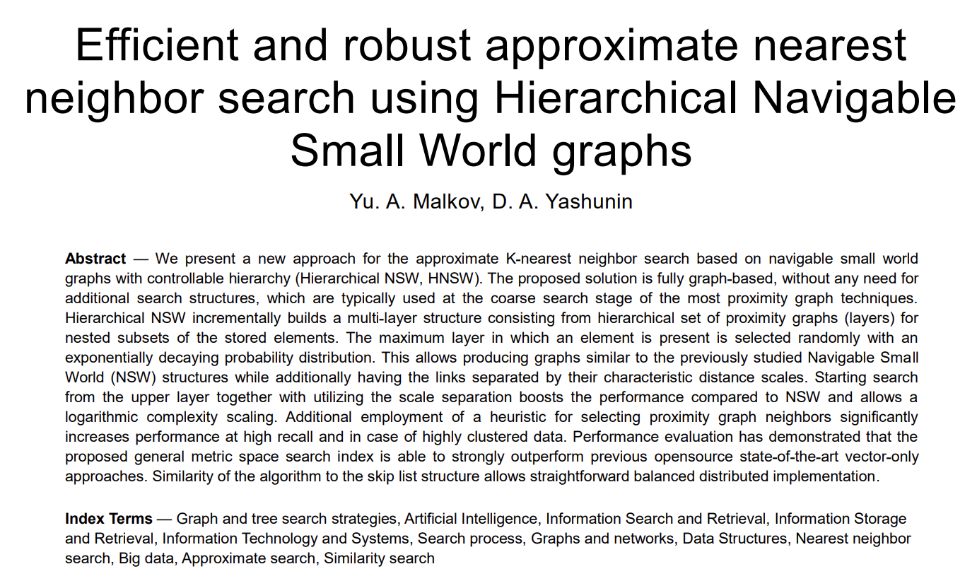
Vector search strategies HNSW
Notes:
, we support a number of characteristics that are beyond the basics for vector retrieval. Among other things, we support two different vector retrieval strategies. One is approximate nearest neighbor search, or ANN search. This will give you a fast and scalable retrieval strategy. What you do is you trade off perfect recall for performance. These are approximate techniques, and in this case we use a well-known approach called HNSW.
Think of it as a probabilistic data structure that builds a graph-type thing, and it allows us to answer questions very fast with a good performance recall trade-off.
We pick good defaults, so you typically don't have to worry about this. But if you actually know what HNSW means and you want to dig into the details, we also give you access to all the parameters so you can fine-tune exactly what we do.
In some other cases, actually it's useful to scan vectors exhaustively, comparing each one of them by computing the distance.
This is typically used to compute a recall base because if you exhaustively review all the vectors, then your recall is perfect, so you can compute the difference between that and your particular scenario. Then there are some corner cases, a very large-scale, and multi-tenancy situations where it actually can be faster to use exhaustive retrieval when your filter selectivity is very high.

Slide 45
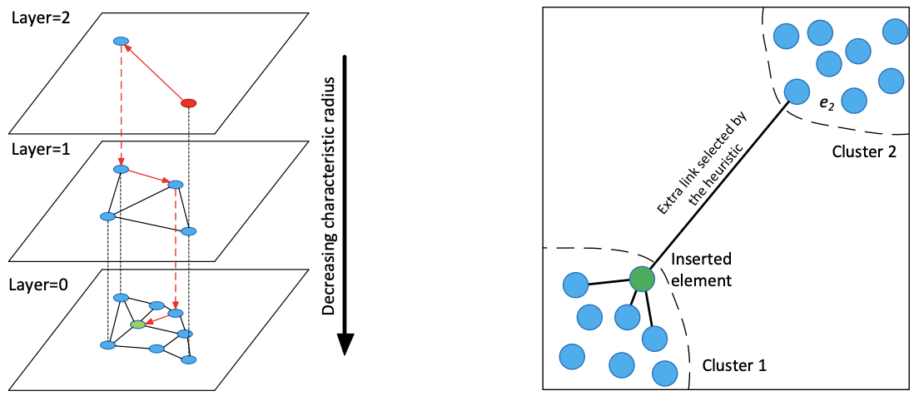
Vector search strategies HNSW
Notes:
, we support a number of characteristics that are beyond the basics for vector retrieval. Among other things, we support two different vector retrieval strategies. One is approximate nearest neighbor search, or ANN search. This will give you a fast and scalable retrieval strategy. What you do is you trade off perfect recall for performance. These are approximate techniques, and in this case we use a well-known approach called HNSW.
Think of it as a probabilistic data structure that builds a graph-type thing, and it allows us to answer questions very fast with a good performance recall trade-off.
We pick good defaults, so you typically don't have to worry about this. But if you actually know what HNSW means and you want to dig into the details, we also give you access to all the parameters so you can fine-tune exactly what we do.
In some other cases, actually it's useful to scan vectors exhaustively, comparing each one of them by computing the distance.
This is typically used to compute a recall base because if you exhaustively review all the vectors, then your recall is perfect, so you can compute the difference between that and your particular scenario. Then there are some corner cases, a very large-scale, and multi-tenancy situations where it actually can be faster to use exhaustive retrieval when your filter selectivity is very high.

Slide 46
Rich vector search query capabilities
Filtered vector search
Scope to date ranges, categories, geographic distances, access control groups, etc.
Rich filter expressions
Pre-/post-filtering
Pre-filter: great for selective filters, no recall disruption
Post-filter: better for low-selectivity filters, but watch for empty results
https://learn.microsoft.com/azure/search/vector-search-filters
r = search_client.search(
None,
top=5,
vector_queries=[VectorizedQuery(
vector=query_vector,
k_nearest_neighbors=5,
fields="embedding")],
vector_filter_mode=VectorFilterMode.PRE_FILTER,
filter=
"tag eq 'perks' and created gt 2023-11-15T00:00:00Z")
Multi-vector scenarios
Multiple vector fields per document
Multi-vector queries
Can mix and match as needed
r = search_client.search(
None,
top=5,
vector_queries=[
VectorizedQuery(
vector=query1, fields="body_vector",
k_nearest_neighbors=5,),
VectorizedQuery(
vector=query2, fields="title_vector",
k_nearest_neighbors=5,)
])
Notes:
As part of building an application, you often need not just vector retrieval, you need other things, like for example, filters are very common. You often want to say, hey, I want to search only on this date range, or maybe employees are in different regions and I want to just search for the policy for a given region and things like that. Filters are often also used for granular access control, so maybe two people ask the same question but get different answers because they can see different documents. We also support pre/post-filtering strategies, this allows you to tune different trade-offs that we make at runtime in terms of how quickly we can get to the right results.
We allow you to support more than single vectors, both in the documents and in the queries. In cases where you want to maybe have a text vector and an image vector, or a title and a body vector and so on, you can just change the query type and it will handle all of this for you. Let me show you a couple of these details in action so you know how does it look like to use these capabilities in Azure AI Search. This is the same query we had before, let's point it back to where it was. I'll just real quick show you two things.

Slide 47




Enterprise ready vector database
Including option for customer-managed encryption keys
Data Encryption
Secure Authentication
Managed identity and RBAC support
Network Isolation
Private endpoints, virtual networks
Extensive certifications across finance, healthcare, government, etc.
Compliance Certifications
Notes:
Not only we provide these rich capabilities for vectors, but also we do this in the backdrop of an enterprise-ready environment. Things like multiple options for data encryption, authentication, including managed identities, my favorite way of not having to deal with API keys, network isolation, and extensive compliance certifications are all part of this offering. All of these things are checked off from the very beginning as you're building solutions for this space. So far we've talked a lot about text.

Slide 48
Not just text
Images, sounds, graphs, and more
Multi-modal embeddings - e.g., images + sentences in Azure AI Vision
Still vectors → vector search applies
RAG with images with GPT-4o with Vision
💻 Demo: Searching images (aka.ms/aitour/image-search)
Notes:
So far we've talked a lot about text.
Yes, you can have a text encoder and do vector similarity in text, that is very popular, but this also works on images, sounds, and other media types as long as you have an embedding model like a vector encoder. There are even some models that will mix multiple media types in the same vector space.
For example, one of the capabilities of the Azure AI Vision Service is to map images and sentences into the same vector space, and because it's the same vector space, comparisons are meaningful, so you can do image-to-image search, or image-to-text search, and so on.
Again, similarity means all the same vectors are changing, is applicable to this scenario. Finally, we're seeing this emerging pattern, this is very old/very new, but in a world where you can search for pictures and then you can use GPT-4 Turbo with Vision to understand the picture. You pretty much can do RAG on pictures too, like you can read a chart, for example, and interpret what's going on
Demo: Notebook, RAG app

Slide 49
Image Search
fields = [
SimpleField(name="id", type=SearchFieldDataType.String, key=True),
SimpleField(name="filename", type=SearchFieldDataType.String),
SearchField(name="embedding",
type=SearchFieldDataType.Collection(SearchFieldDataType.Single),
searchable=True,
vector_search_dimensions=1024,
vector_search_profile_name="embedding_profile")
]

Slide 50
Image Search
import mimetypes
import os import requests
from PIL import Image
token_provider =
get_bearer_token_provider(azure_credential, "https://cognitiveservices.azure.com/.default")
AZURE_COMPUTERVISION_SERVICE = os.getenv("AZURE_COMPUTERVISION_SERVICE")
AZURE_COMPUTER_VISION_URL = f"https://{AZURE_COMPUTERVISION_SERVICE}.cognitiveservices.azure.com/computervision/retrieval"

Slide 51
Image Search
def get_model_params():
return {"api-version": "2023-02-01-preview", "modelVersion": "latest"}
def get_auth_headers():
return {"Authorization": "Bearer " + token_provider()}

Slide 52
Image Search
def get_image_embedding(image_file):
mimetype = mimetypes.guess_type(image_file)[0]
url = f"{AZURE_COMPUTER_VISION_URL}:vectorizeImage"
headers = get_auth_headers()
headers["Content-Type"] = mimetype
# add error checking
response = requests.post(url, headers=headers, params=get_model_params(), data=open(image_file, "rb"))
if response.status_code != 200:
print(image_file, response.status_code, response.json())
return response.json()["vector"]

Slide 53
Image Search
def get_text_embedding(text):
url = f"{AZURE_COMPUTER_VISION_URL}:vectorizeText"
return requests.post(
url,
headers=get_auth_headers(), params=get_model_params(),
json={"text": text}).json()["vector"]

Slide 54
Image Search
for image_file in os.listdir("product_images"):
image_embedding =
get_image_embedding(f"product_images/{image_file}")
search_client.upload_documents(documents=[{
"id": image_file.split(".")[0],
"filename": image_file,
"embedding": image_embedding}])

Slide 55

Image Search
query_image = "query_images/tealightsand_side.jpg"
Image.open(query_image)

Slide 56
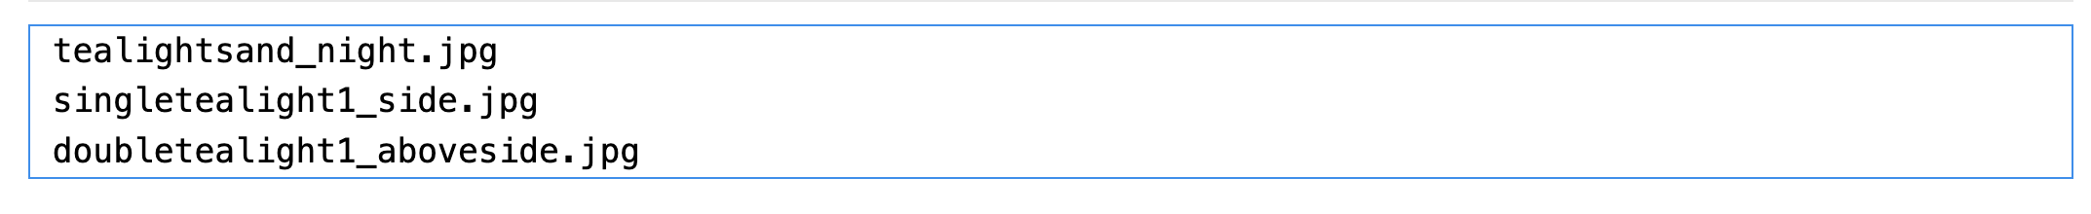
Image Search
query_vector = get_image_embedding(query_image)
r = search_client.search(None, vector_queries=[
VectorizedQuery(vector=query_vector, k_nearest_neighbors=3, fields="embedding")])
all = [doc["filename"] for doc in r]
for filename in all:
print(filename)

Slide 57
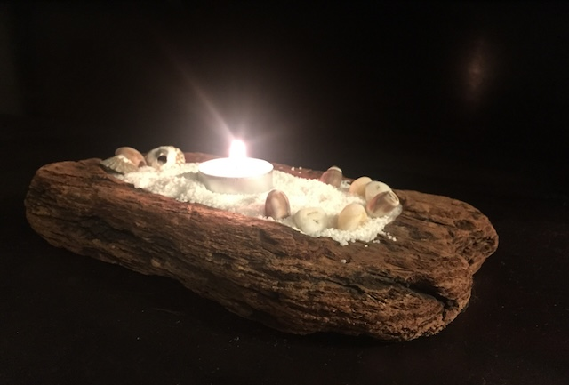
Image Search
Image.open("product_images/" + all[0])

Slide 58
Image Search
query_vector = get_text_embedding("lion king")
r = search_client.search(None, vector_queries=[
VectorizedQuery(vector=query_vector, k_nearest_neighbors=3, fields="embedding")])
all = [doc["filename"] for doc in r]
for filename in all:
print(filename)

Slide 59
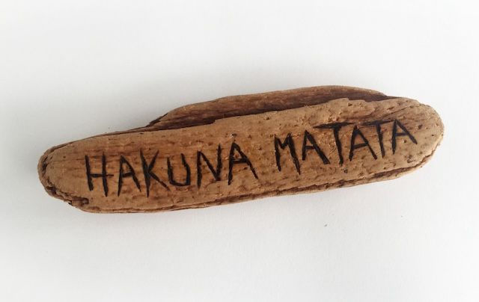
Image Search
Image.open("product_images/" + all[0])

Slide 60
Image Search
query_vector = get_text_embedding("rey leon")
r = search_client.search(None, vector_queries=[
VectorizedQuery(vector=query_vector, k_nearest_neighbors=3, fields="embedding")])
all = [doc["filename"] for doc in r]
for filename in all:
print(filename)

Slide 61
Azure AI Search:​
State-of-the-art retrieval system​

Slide 62
Relevance
Relevance is critical for RAG apps
Lots of passages in prompt → degraded quality
→ Can’t only focus on recall
Incorrect passages in prompt → possibly well-grounded yet wrong answers
→ Helps to establish thresholds for “good enough” grounding data
Accuracy
Number of documents in input context
Source: Lost in the Middle: How Language Models Use Long Contexts, Liu et al. arXiv:2307.03172

Slide 63
Improving relevance
All information retrieval tricks apply!
Complete search stacks do better:
Hybrid retrieval (keywords + vectors) > pure-vector or keyword
Hybrid + Reranking > Hybrid
Identify good & bad candidates
Normalized scores from Semantic ranker
Exclude documents below a threshold
Reranking
Fusion (RRF)
Vector
Keywords
💻 Demo: Compare text, vector, hybrid, reranker
(aka.ms/aitour/search-relevance)

Slide 64
Search Relevance
search_query = "$45.00"
search_vector = get_embedding(search_query)
r = search_client.search(None, top=3, vector_queries=[
VectorizedQuery(
vector=search_vector,
k_nearest_neighbors=50, fields="embedding")])

Slide 65
Search Relevance
for doc in r:
found_content = "Not found"
if search_query in doc['content’]:
found_content =
doc['content'][doc['content'].find(search_query):].replace("\n", " ")
print(f"Score: {doc['@search.score']:.5f}\tMatching text: {found_content}")

Slide 66
Search Relevance
search_query = "$45.00"
search_vector = get_embedding(search_query)
r = search_client.search(None, top=3, vector_queries=[
VectorizedQuery(
vector=search_vector,
k_nearest_neighbors=50, fields="embedding")])

Slide 67
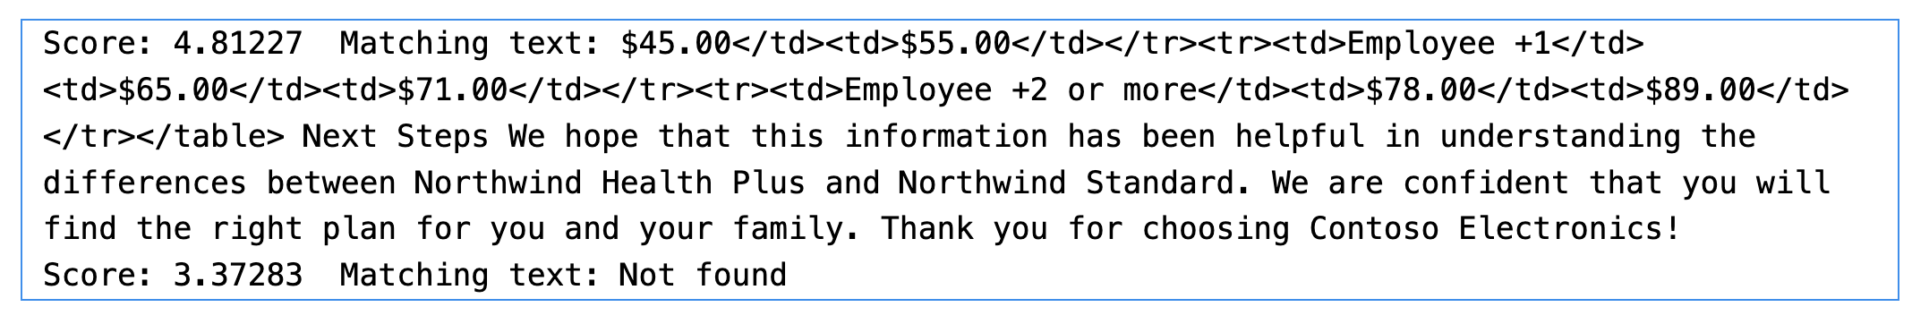
Search Relevance
search_query = "$45.00"
search_vector = get_embedding(search_query)
r = search_client.search()
for doc in r:
found_content = "Not found"
if search_query in doc['content’]:
found_content =
doc['content'][doc['content'].find(search_query):].replace("\n", " ")
print(f"Score: {doc['@search.score']:.5f}\tMatching text: {found_content}")

Slide 68
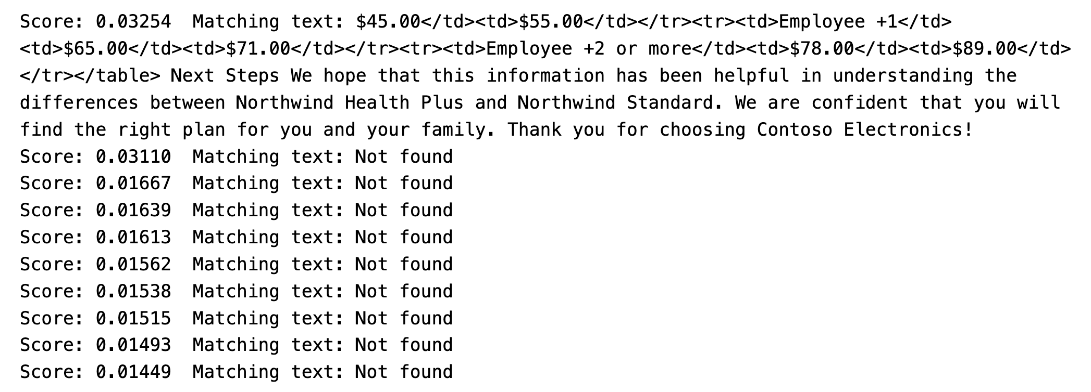
Search Relevance
search_query = "$45.00"
search_vector = get_embedding(search_query)
r = search_client.search(search_query, top=15, vector_queries=[
VectorizedQuery(vector=search_vector, k_nearest_neighbors=10, fields="embedding")])

Slide 69
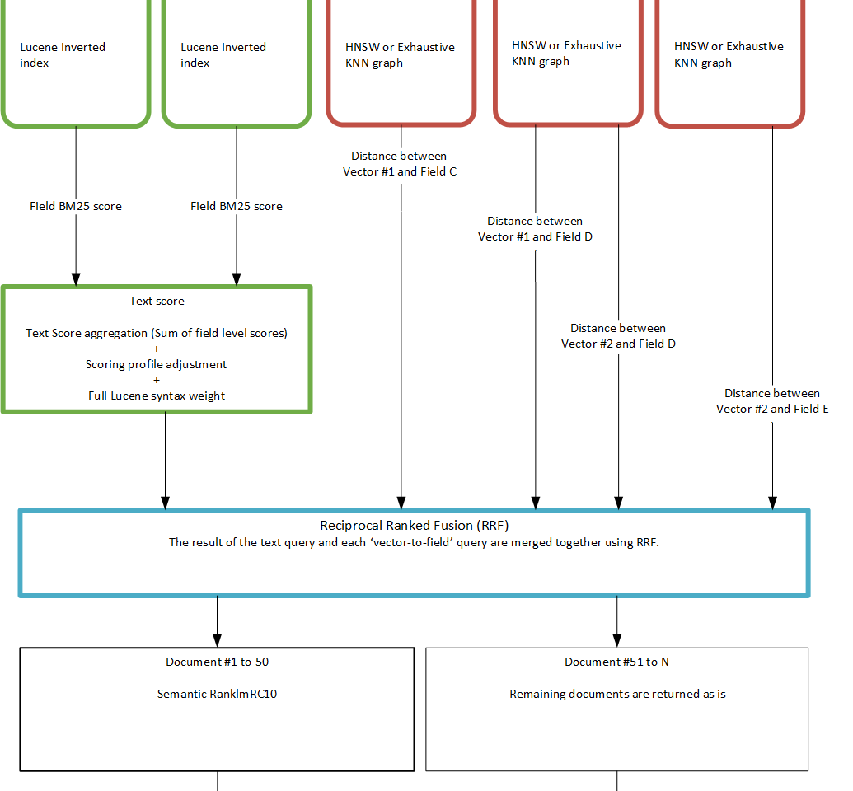
Search Relevance – Reciprocal Rank Fusion (RRF)
https://aka.ms/hybrid-search-ranking

Slide 70
Hybrid ranking is not always optimal
search_query = "learning about underwater activities"
search_vector = get_embedding(search_query)
r = search_client.search(search_query, top=5, vector_queries=[
VectorizedQuery(
vector=search_vector,
k_nearest_neighbors=10, fields="embedding")])

Slide 71
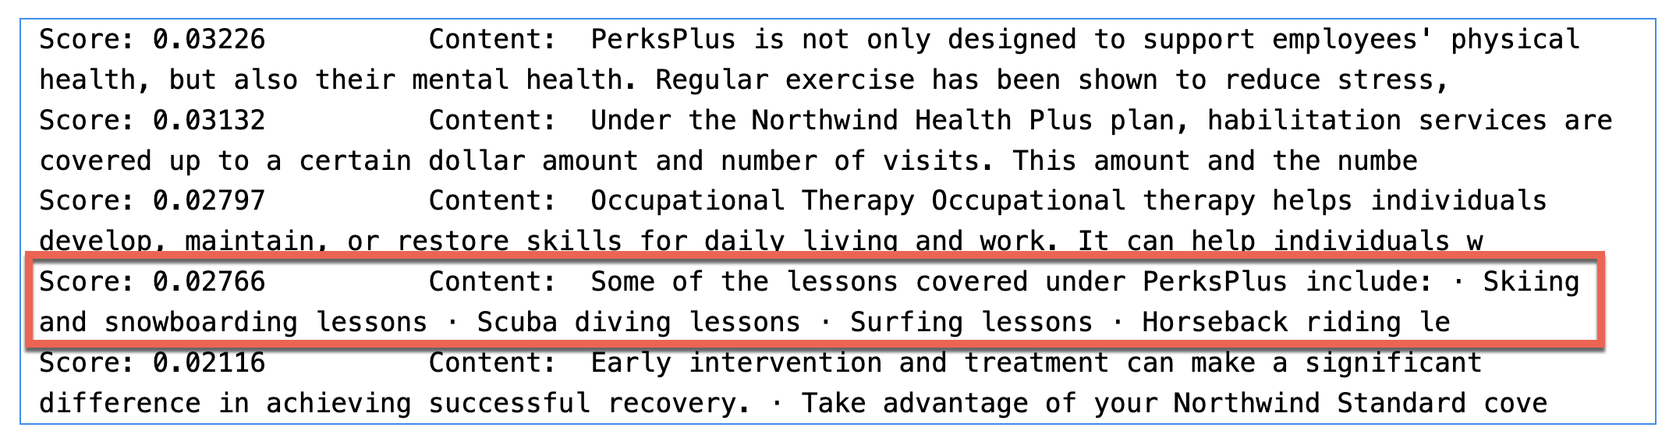
Hybrid ranking is not always optimal

Slide 72
Hybrid + semantic reranking 🎉
search_query = "learning about underwater activities"
search_vector = get_embedding(search_query)
r = search_client.search(search_query, top=5,
vector_queries=[
VectorizedQuery(
vector=search_vector,
k_nearest_neighbors=50, fields="embedding")],
query_type="semantic",
semantic_configuration_name="default")

Slide 73
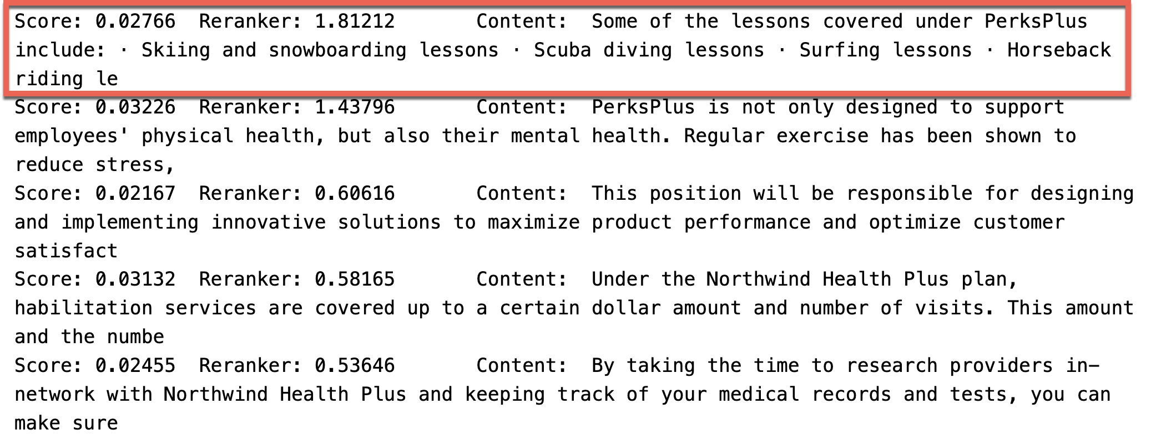
Hybrid + semantic reranking 🎉

Slide 74
Semantic ranker
Generally available
SOTA re-ranking model
Highest performing retrieval mode
Multilingual capabilities
Includes extractive answers, captions and ranking
*Formerly semantic search
Notes:
Using hybrid search and semantic ranker deliver highest performing results.

Slide 75
Semantic ranker
SOTA re-ranking model
Highest performing retrieval mode
New pay-go pricing: Free 1k requests/month, $1 per additional 1k
Multilingual capabilities
Includes extractive answers, captions and ranking
Generally available
*Formerly semantic search
Notes:
Using hybrid search and semantic ranker deliver highest performing results.

Slide 76
Retrieval relevance across methods
Retrieval comparison using Azure AI Search in various retrieval modes on customer and academic benchmarks
Source: Outperforming vector search with hybrid + reranking

Slide 77
Impact of query types on relevance
Query type | Keyword [NDCG@3] | Vector [NDCG@3] | Hybrid [NDCG@3] | Hybrid + Semantic ranker [NDCG@3]
Concept seeking queries | 39 | 45.8 | 46.3 | 59.6
Fact seeking queries | 37.8 | 49 | 49.1 | 63.4
Exact snippet search | 51.1 | 41.5 | 51 | 60.8
Web search-like queries | 41.8 | 46.3 | 50 | 58.9
Keyword queries | 79.2 | 11.7 | 61 | 66.9
Low query/doc term overlap | 23 | 36.1 | 35.9 | 49.1
Queries with misspellings | 28.8 | 39.1 | 40.6 | 54.6
Long queries | 42.7 | 41.6 | 48.1 | 59.4
Medium queries | 38.1 | 44.7 | 46.7 | 59.9
Short queries | 53.1 | 38.8 | 53 | 63.9
Source: Outperforming vector search with hybrid + reranking

Slide 78
Azure AI Search:​
Seamless Data and Platform Integrations​

Slide 79


Data preparation for RAG applications
Chunking
Split long-form text into short passages
LLM context length limits
Focused subset of the content
Multiple independent passages
Basics
~200–500 tokens/passage
Maintain lexical boundaries
Introduce overlap
Layout
Layout information is valuable, e.g., tables
Vectorization
Indexing-time: convert passages to vectors
🔗 Example: Data preparation process
Notes:
Chunking refers to a fact that you usually don't want long documents, you want to chop them up in passages and there is a lot of detail to consider there. In addition to that, then, you have to turn those passages into vectors when you are indexing. At query time, you have to turn the query into a vector so you can run the comparison. While you can do all of this by hand and we give you APIs so you can control all of this picture, we also want to make it easy for you to do the end-to-end and not have to repeat this process.

Slide 80
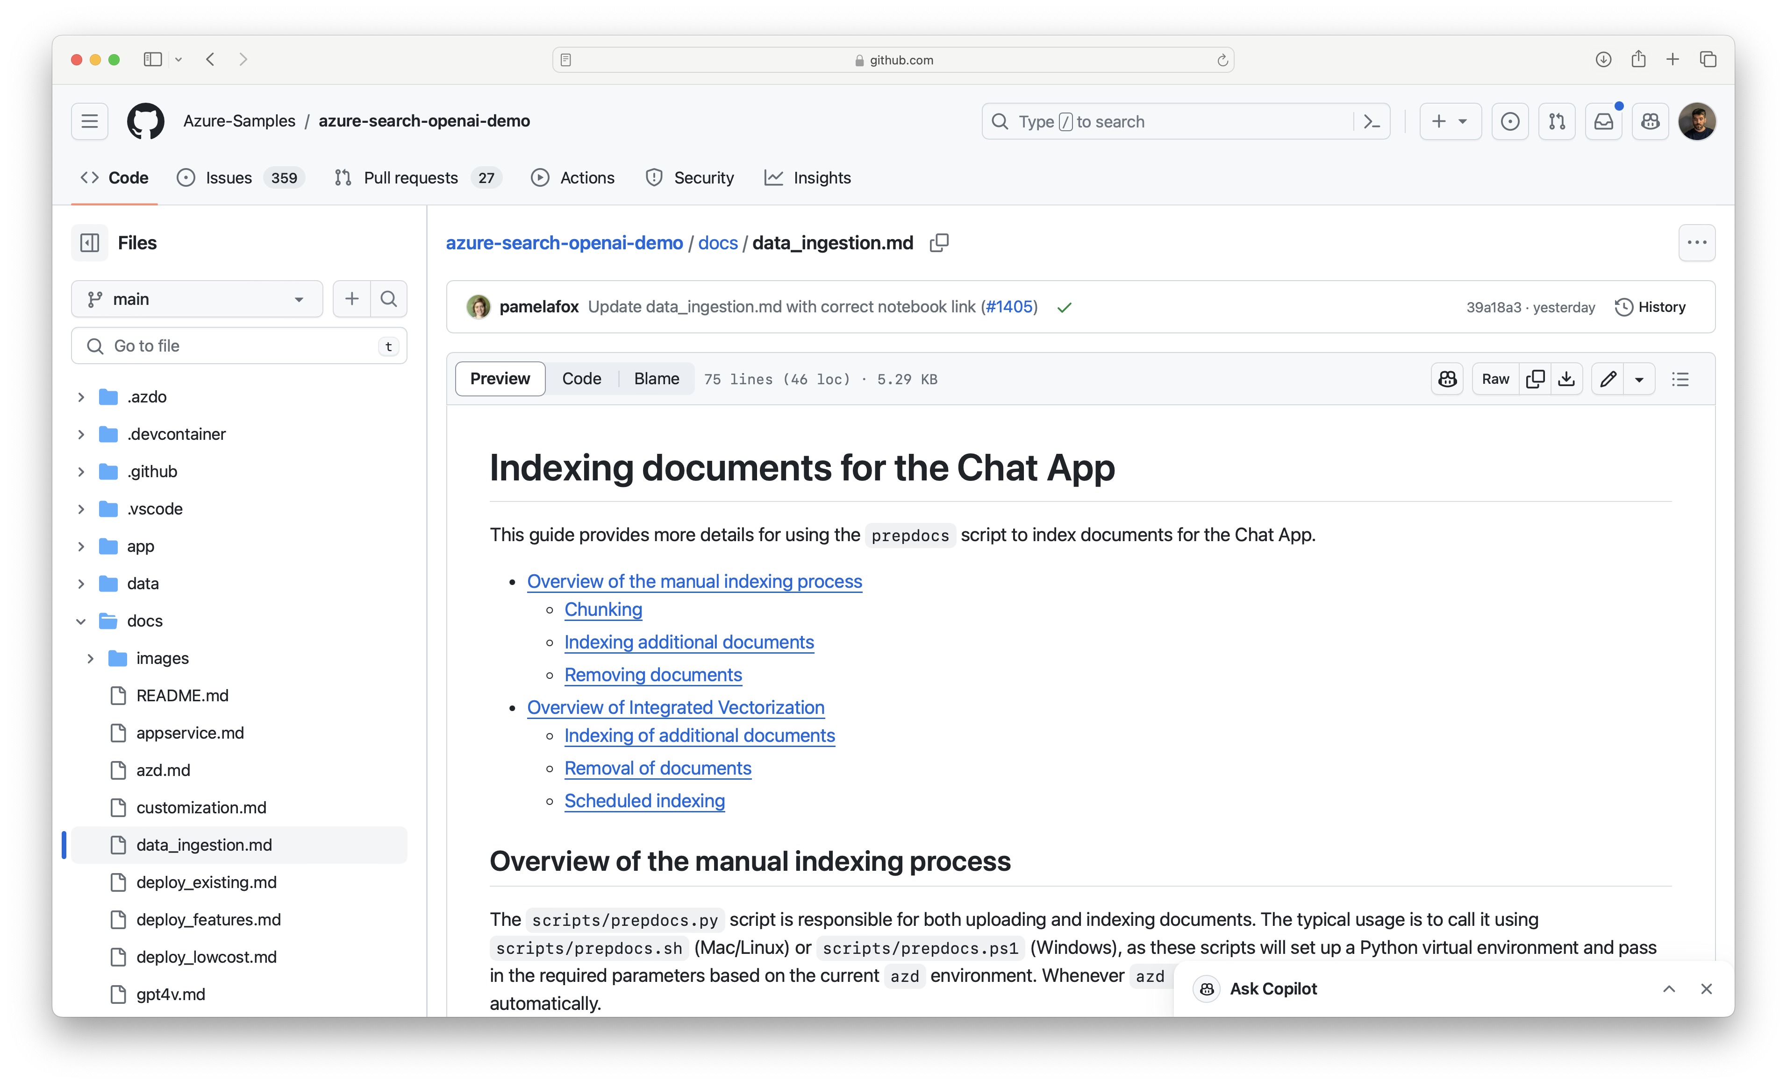
Data preparation for RAG applications
https://github.com/Azure-Samples/
Notes:
Chunking refers to a fact that you usually don't want long documents, you want to chop them up in passages and there is a lot of detail to consider there. In addition to that, then, you have to turn those passages into vectors when you are indexing. At query time, you have to turn the query into a vector so you can run the comparison. While you can do all of this by hand and we give you APIs so you can control all of this picture, we also want to make it easy for you to do the end-to-end and not have to repeat this process.

Slide 81
Integrated vectorization End-to-end data processing tailored to RAG
Data source access
Blob Storage
ADLSv2
SQL DB
CosmosDB
…
Incremental change tracking
File format cracking
PDFs
Office documents
JSON files
…
Extract images and text, OCR as needed
Chunking
Split text into passages
Propagate document metadata
Vectorization
Turn chunks into vectors
OpenAI embeddings or your custom model
Indexing
Document index
Chunk index
Both
https://learn.microsoft.com/azure/search/vector-search-integrated-vectorization

Slide 82
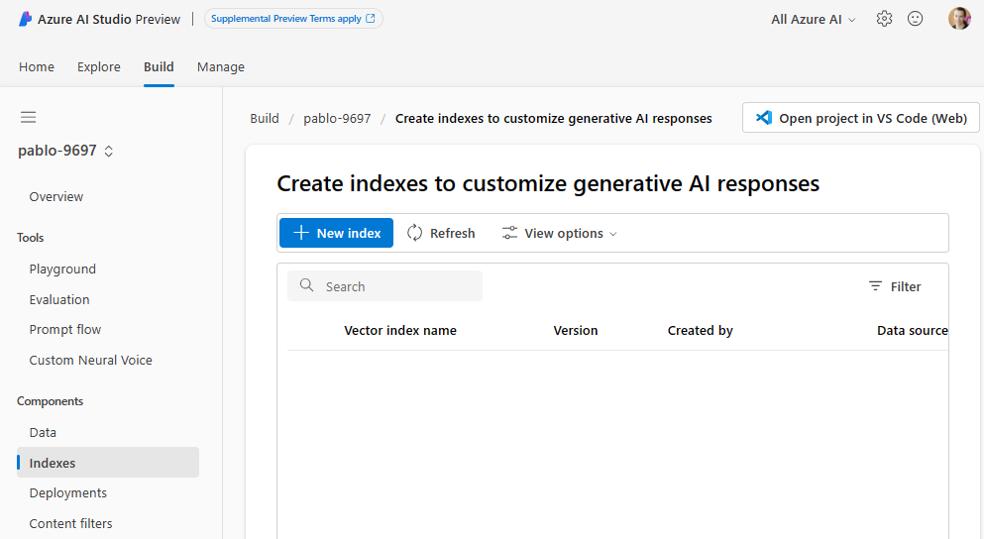
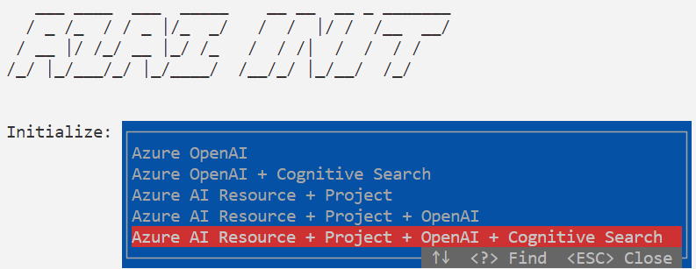
Azure AI Studio & Azure AI SDK
First-class integration
Build indexes from data in Blob Storage, Microsoft Fabric, etc.
Attach to existing Azure AI Search indexes

Slide 83
Use cases

Slide 84
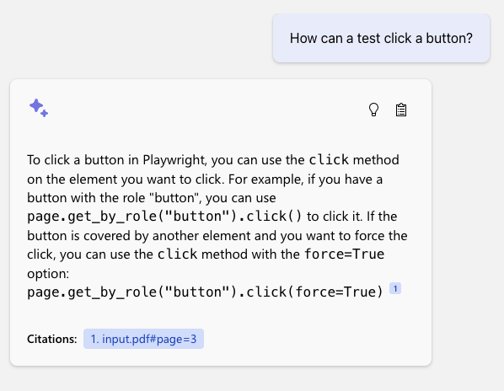
Example uses
Developers have used Azure AI search to create RAG apps for…
Public government data
Internal HR documents, company meetings, presentations
Customer support requests and call transcripts
Technical documentation and issue trackers
Product manuals

Slide 85
Next steps
Learn more about Azure AI Search
https://aka.ms/AzureAISearch
Dig more into quality evaluation details and why Azure AI Search will make your application generate better results
https://aka.ms/ragrelevance
Deploy a RAG chat application for your organization’s data
https://aka.ms/azai/python
Explore Azure AI Studio for a complete RAG development experience
https://aka.ms/AzureAIStudio

Slide 86
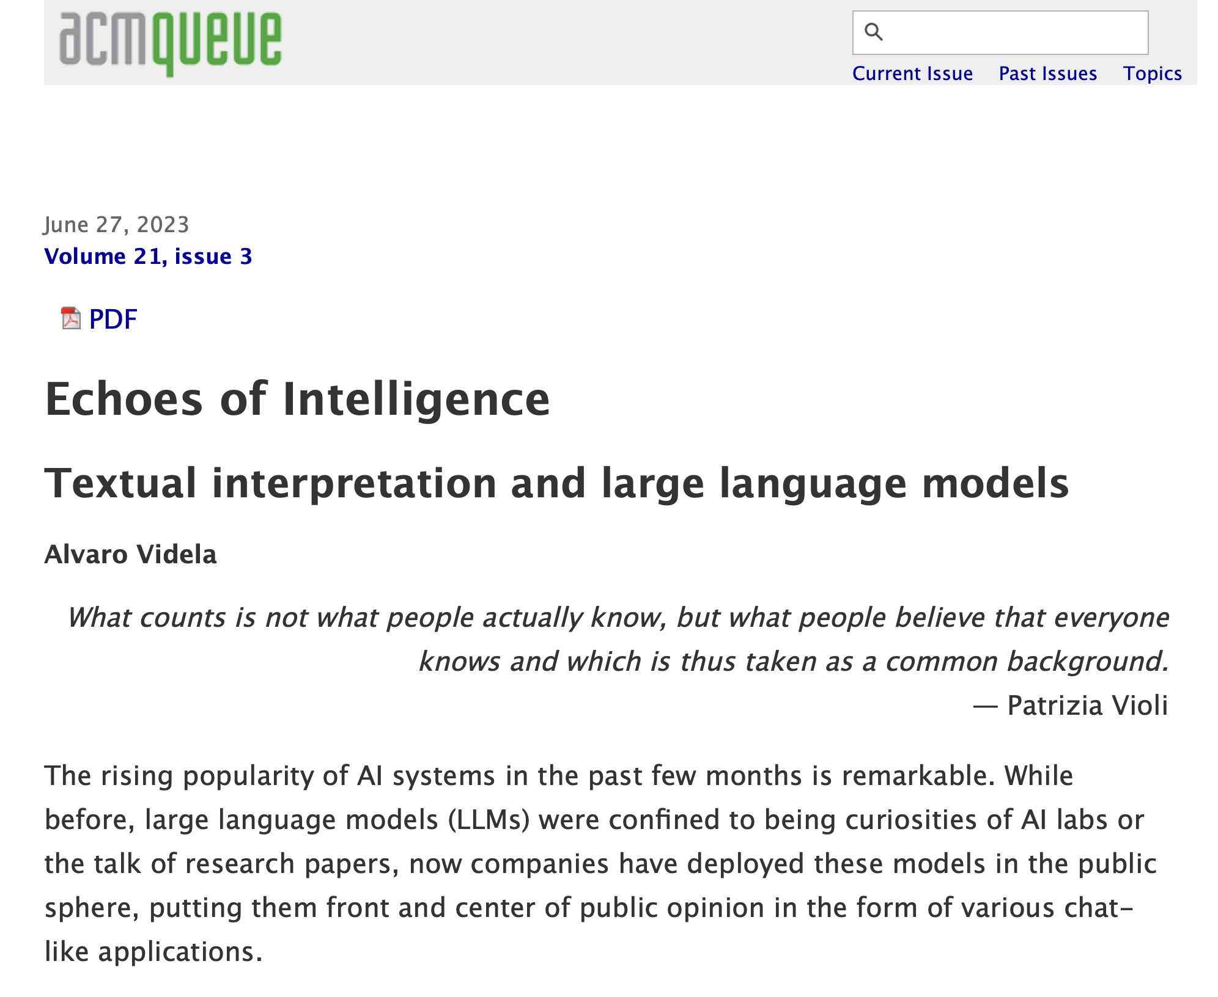
Echoes of Intelligence - Semiotic look at GenAI
https://queue.acm.org/detail.cfm?id=3606011

Slide 87
“You can't always get what you want But if you try sometimes, well, you might find You get what you need”

